Slide 1
The Benefits of Remote Work: Empowering Productivity & Well-being
Created by: Gayatri Gorde

Slide 2

Increased Productivity: Focus & Flexibility
Fewer Distractions: Reduced office noise and interruptions.
Customized Environment: Optimize your workspace for peak performance.
Flexible Scheduling: Work when you're most productive. (e.g., early bird or night owl).
Higher Concentration: Enables deeper focus and improved task completion.

Slide 3

Enhanced Employee Well-being: Work-Life Harmony
Reduced Commute Stress: Reclaim valuable time and energy.
Improved Work-Life Balance: Greater control over personal and professional life.
Increased Autonomy: Fosters a sense of ownership and responsibility.
Better Mental Health: Reduced stress and improved overall well-being.

Slide 4

Cost Savings: For Employees & Employers
Employee Savings: Reduced commuting costs (gas, public transport, parking), work attire expenses, and meals.
Employer Savings: Lower office space costs (rent, utilities), reduced absenteeism, and potentially lower salaries in competitive markets.

Slide 5

Wider Talent Pool: Access to Global Expertise
Recruit the Best: Hire skilled professionals regardless of location.
Increased Diversity: Tap into a more diverse workforce.
Reduced Relocation Costs: Eliminates the need for relocation packages.
Greater Innovation: Diverse perspectives lead to more creative solutions.

Slide 6

Improved Employee Retention: A Key Benefit
Increased Job Satisfaction: Happy employees are less likely to leave.
Enhanced Loyalty: Remote work is often perceived as a valuable perk.
Reduced Turnover Costs: Hiring and training new employees is expensive.
Stronger Employer Brand: Attract and retain top talent by offering remote opportunities.

Slide 7

Environmental Benefits: A Sustainable Approach
Reduced Carbon Footprint: Fewer commutes lead to lower emissions.
Less Office Waste: Reduced paper consumption and energy usage.
Sustainable Practices: Aligning with environmental responsibility goals.
Contributes to a Greener Future: Supporting a more sustainable and eco-friendly work culture.

Slide 8

Technology Enables Seamless Collaboration
Communication Tools: Slack, Microsoft Teams, Zoom, Google Meet.
Project Management Software: Asana, Trello, Jira.
Cloud-Based Platforms: Google Workspace, Microsoft 365, Dropbox.
Virtual Meeting Etiquette: Clear communication, active listening, and structured agendas are key to collaboration.

Slide 9
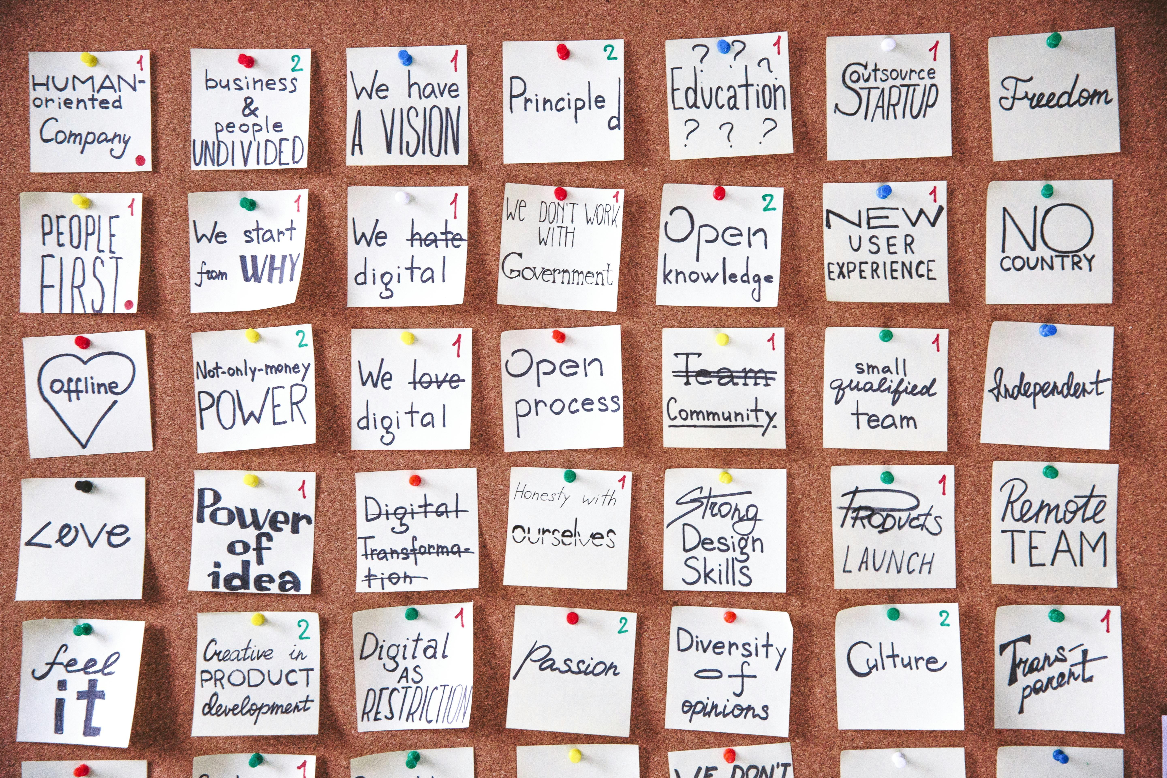
Addressing Challenges & Ensuring Success
Clear Communication Protocols: Establish guidelines for communication and responsiveness.
Defined Expectations & Goals: Set clear objectives and performance metrics.
Regular Check-ins & Feedback: Provide consistent support and guidance.
Promote Team Building Activities: Foster a sense of community and connection.

Slide 10
Remote Work: A Win-Win for the Future
Embrace the power of remote work to unlock increased productivity, enhanced well-being, and a more sustainable future for your organization and employees.

